Slide 1
Text Classification

Slide 2
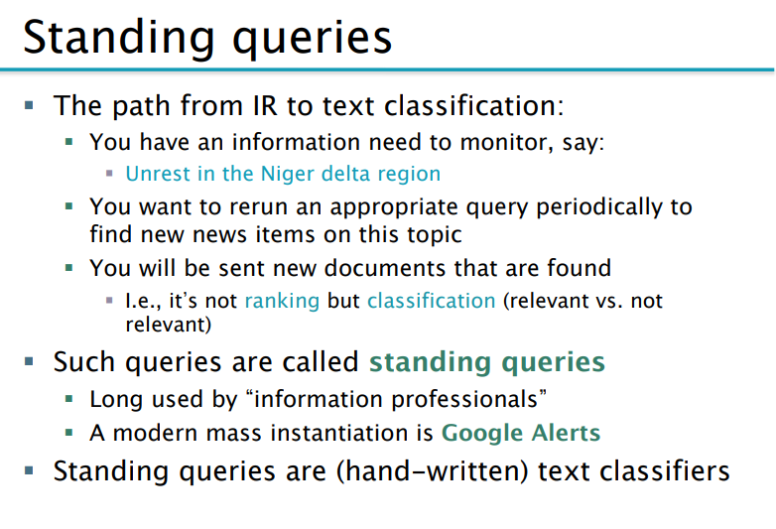

Slide 3
Standing Query
Query : Multicore Computer chips
Automating the repetitive task.
A standing query is like any other query except that it is periodically executed on a collection to which new documents are incrementally added over time.
Redefine standing query over time.
Standing query keeps generality and scope of problem space.
Given a set of classes, determine which class(es) a given object belongs to.
the standing query serves to divide new newswire articles into the two classes: documents about multicore computer chips and documents not about multicore computer chips. This is two class classification. Using standing query, classification also called routing or filtering .

Slide 4
General Classification
Topics, text classification , text categorization or topic spotting.
The notion of classification is very general and has many applications within and beyond information retrieval (IR).

Slide 5
Examples from IR in Text Classification
Example in Computer vision ?
Initially Several of the preprocessing steps necessary for indexing
The automatic detection of spam pages (which then are not included in the
The automatic detection of explicitly indecent content
SENTIMENT DETECTION: movie or product review
Email Sorting:
Vertical Search Engine: Vertical search engines restrict searches to a particular topic.

Slide 6
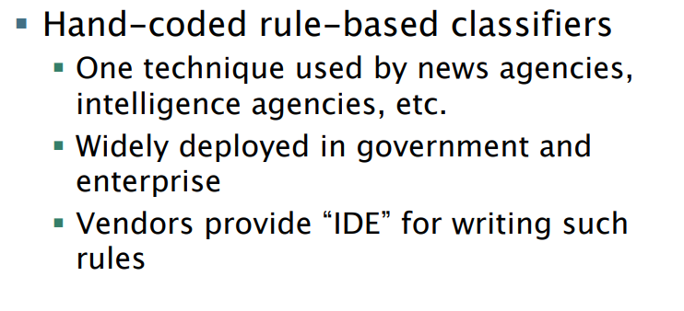
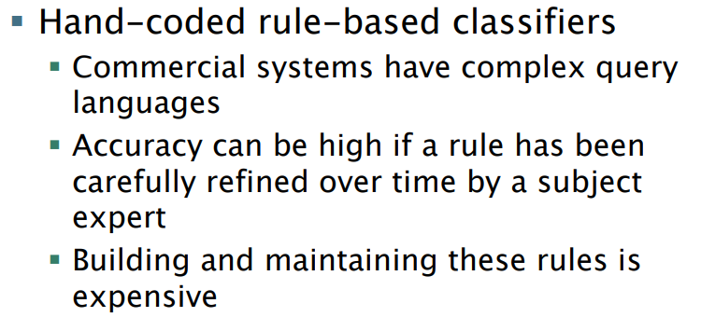

Slide 7
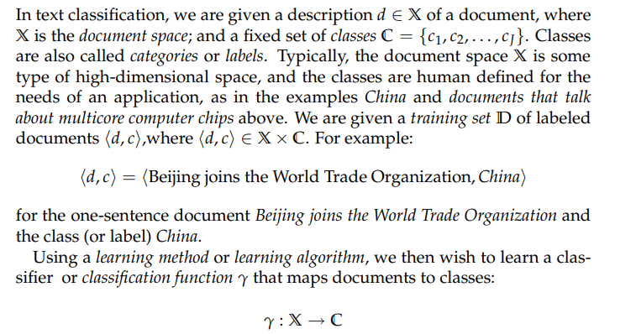
Statistical text Classification
Manual, Rule based, Machine learning based.
ML still manual.

Slide 8
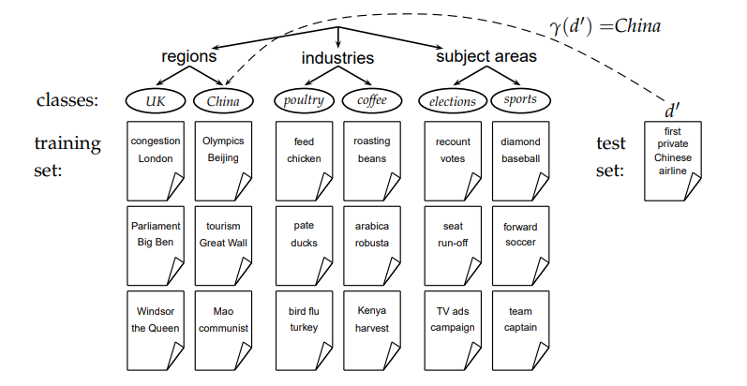

Slide 9
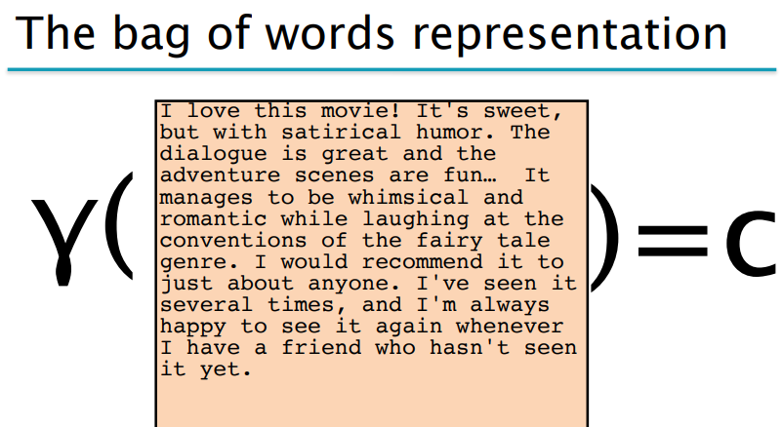
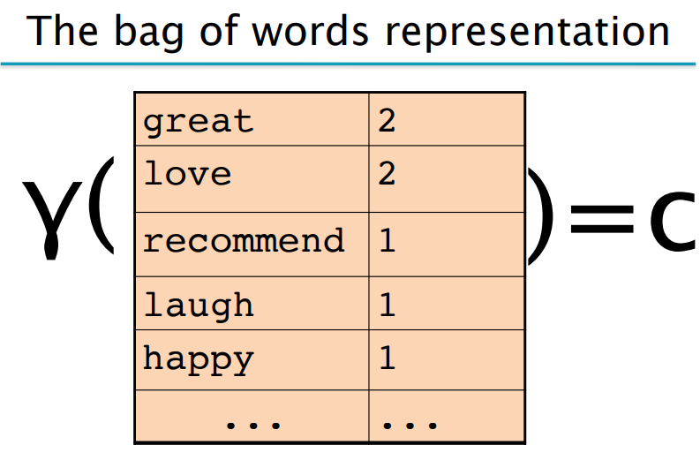

Slide 10
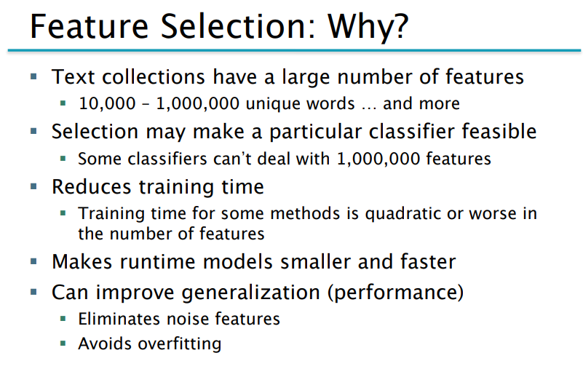

Slide 11

Naïve Bayes text Classification
The probability of a document d being in class c is computed as
P(tk |c) is the conditional probability of term tk occurring in a document of class c

Slide 12
